Slide 1
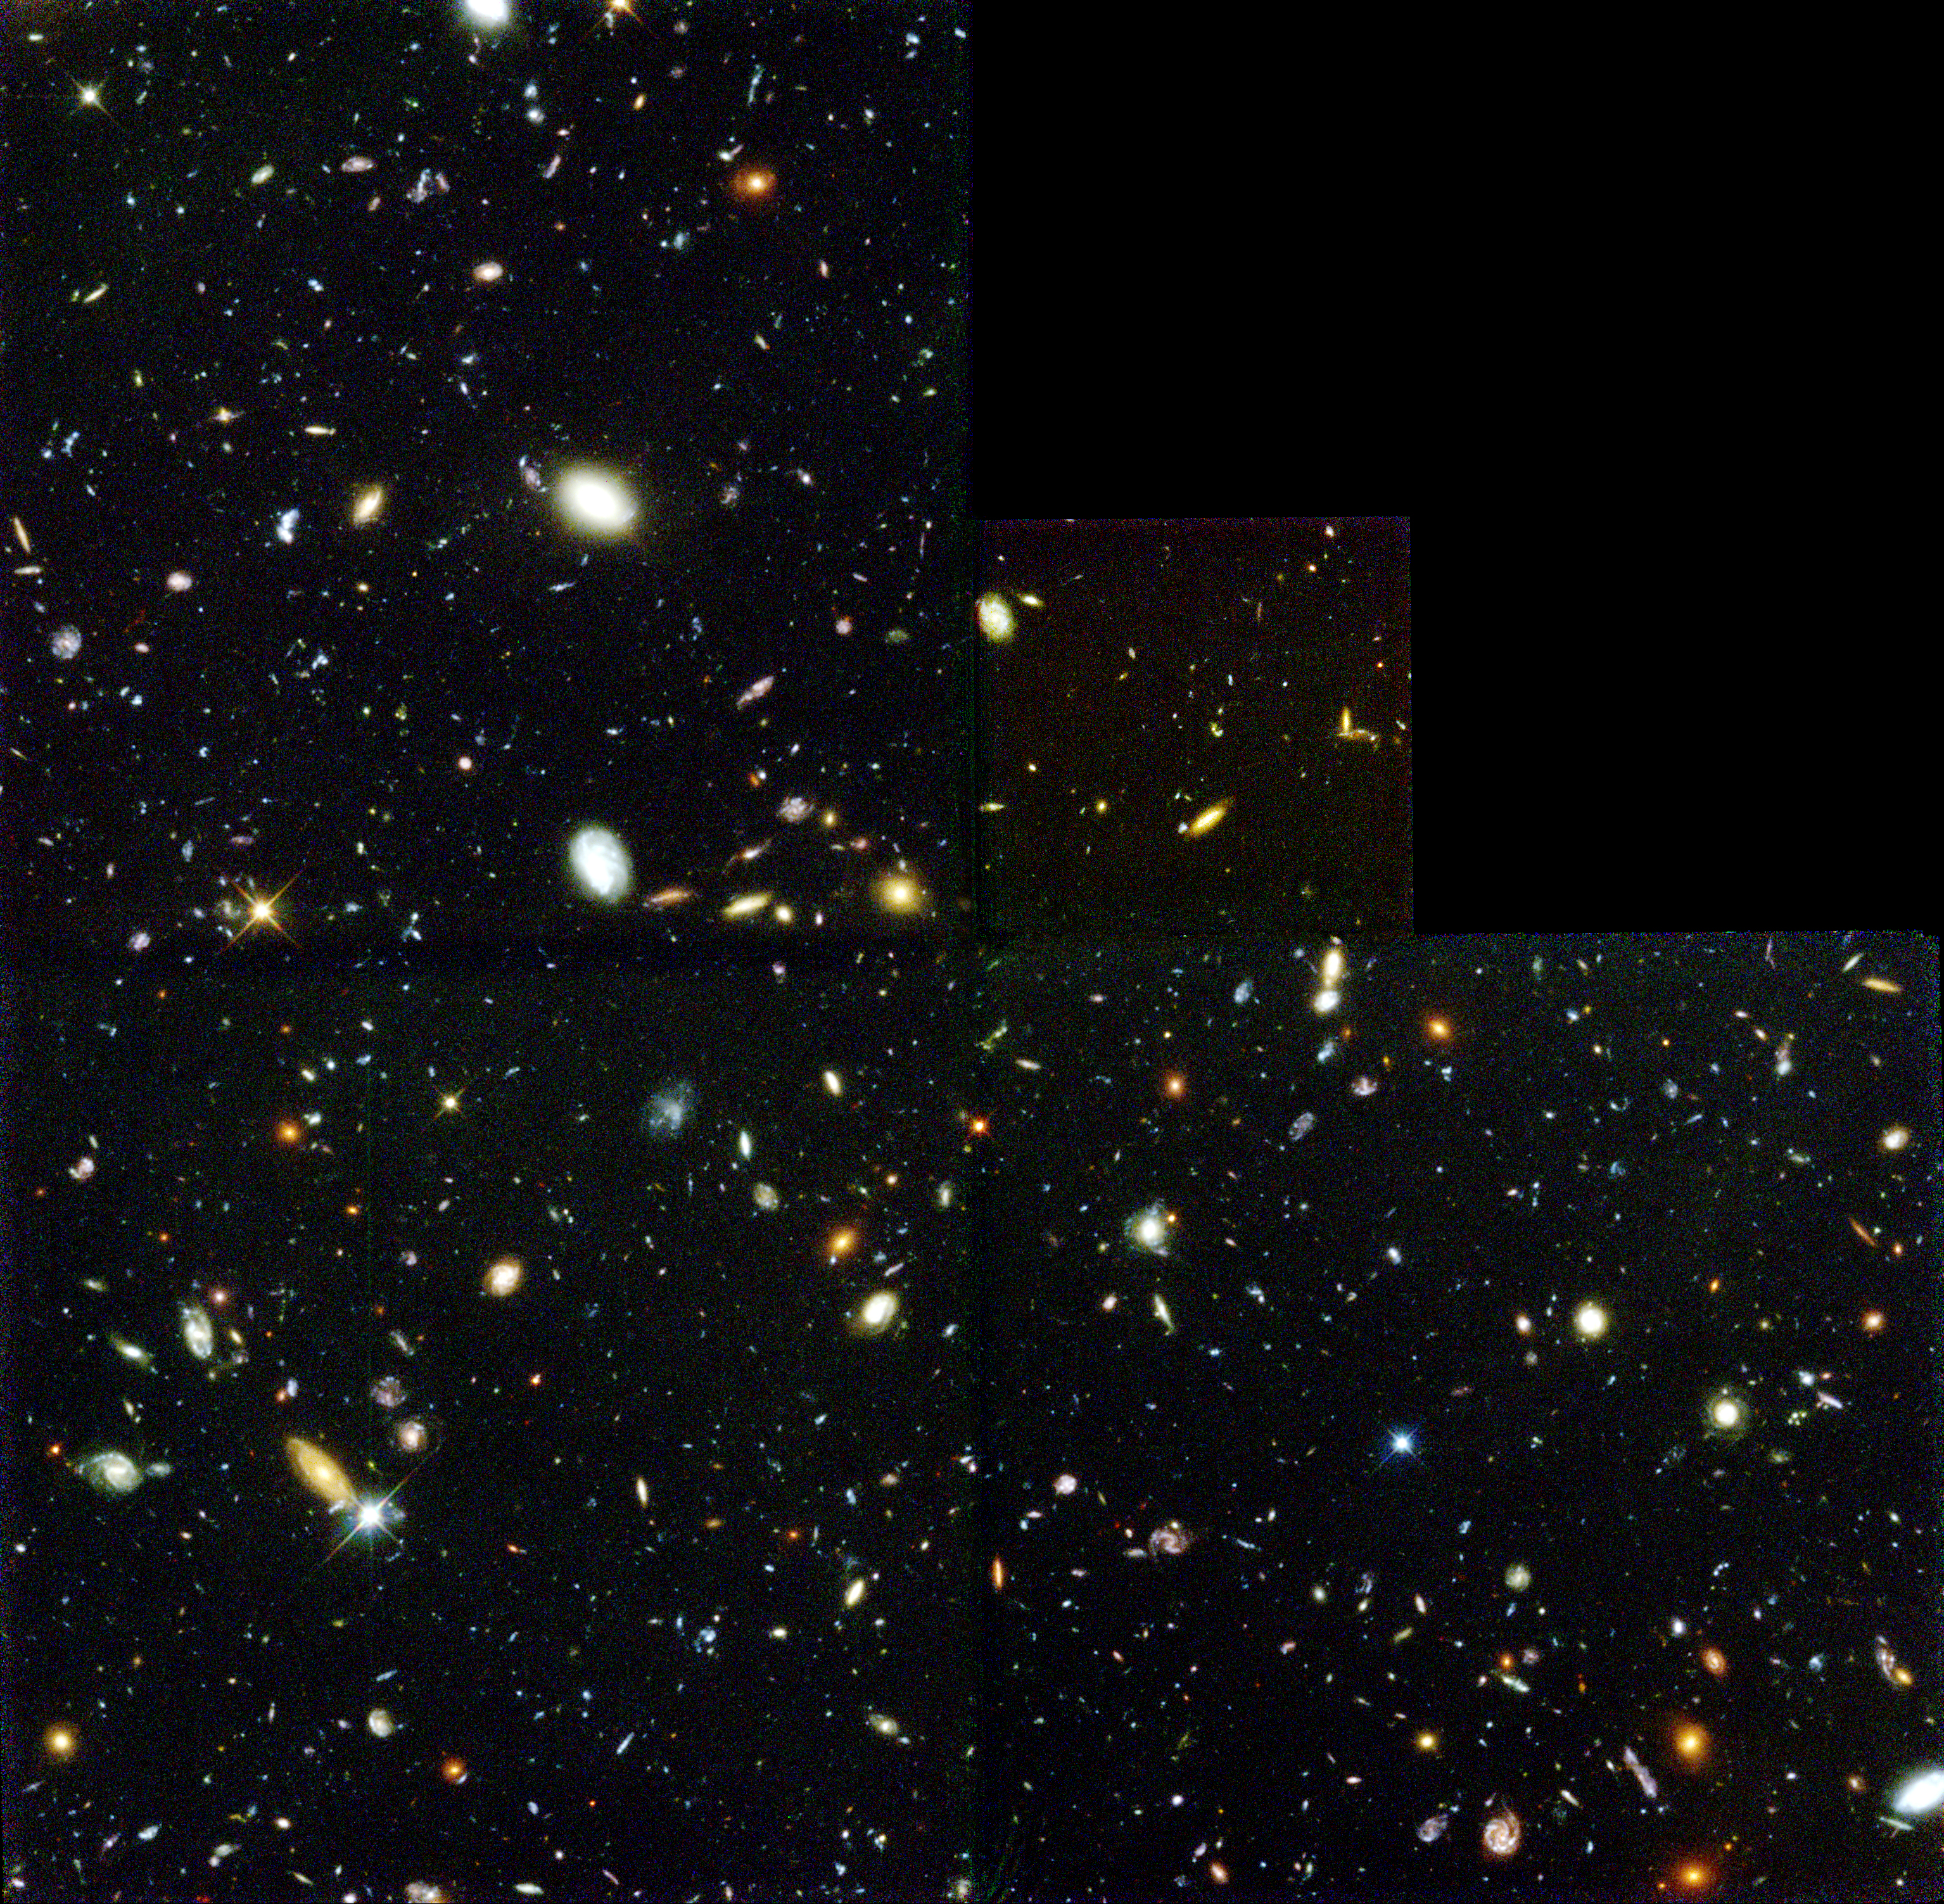
The Universe Around Us Unit 2: Cosmology (day two)

Slide 2
Hubble Deep Field (HDF; 1995)

Slide 3
Hubble Deep Field (HDF; 1995)
2.6’
2.6’

Slide 4
Hubble Deep Field (HDF; 1995)
(1/24,000,000 of the sky)
2.6’
2.6’

Slide 5
1. The Great Debate
& the distance ladder

Slide 6
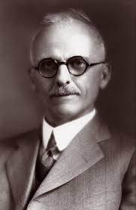
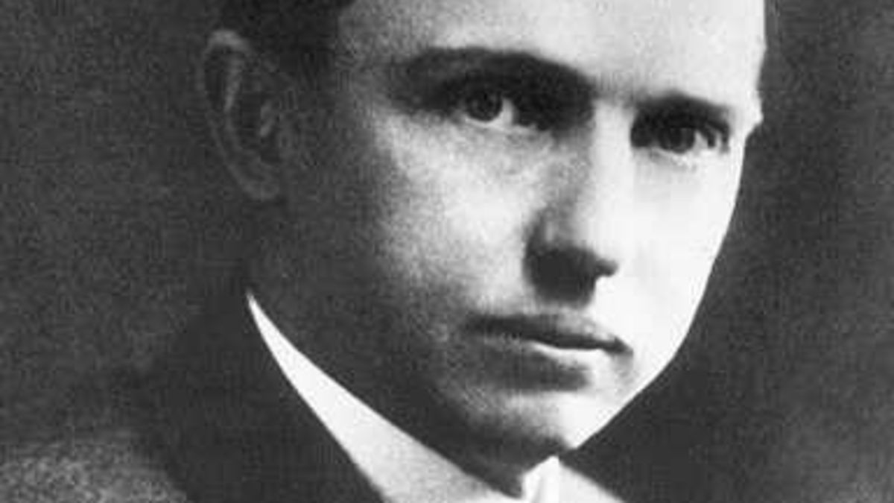
The Great Debate (1920)
(1885-1972) Harlow Shapley
(1872-1942)
Heber Curtis
V
S
“Our galaxy is the universe”
“No.”

Slide 7
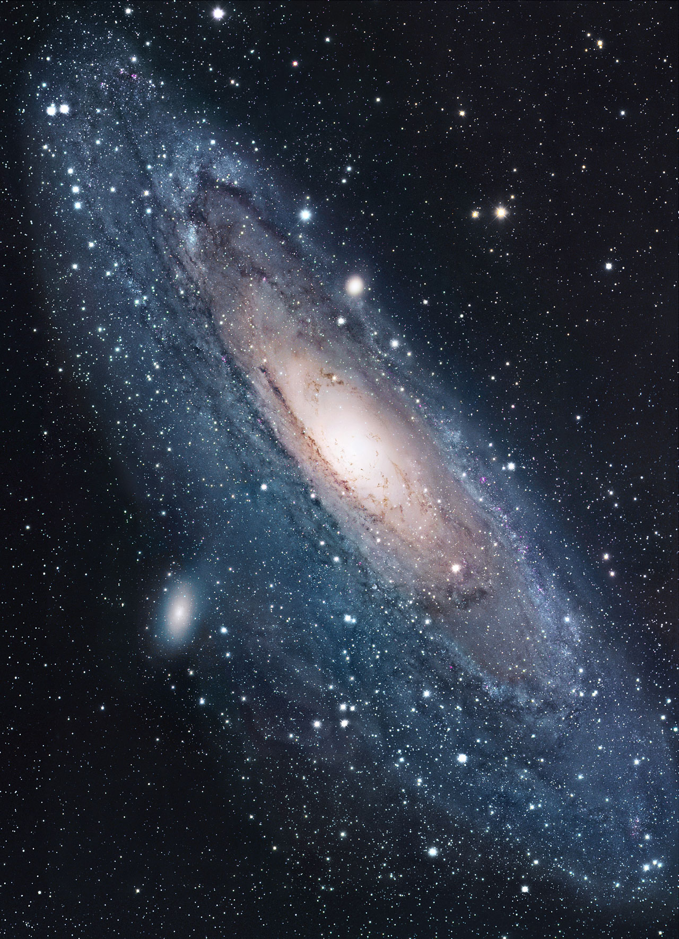
The Great Debate (1920)
(1885-1972) Harlow Shapley
(1872-1942)
Heber Curtis
V
S
“Our galaxy is the universe”
“No.”

Slide 8
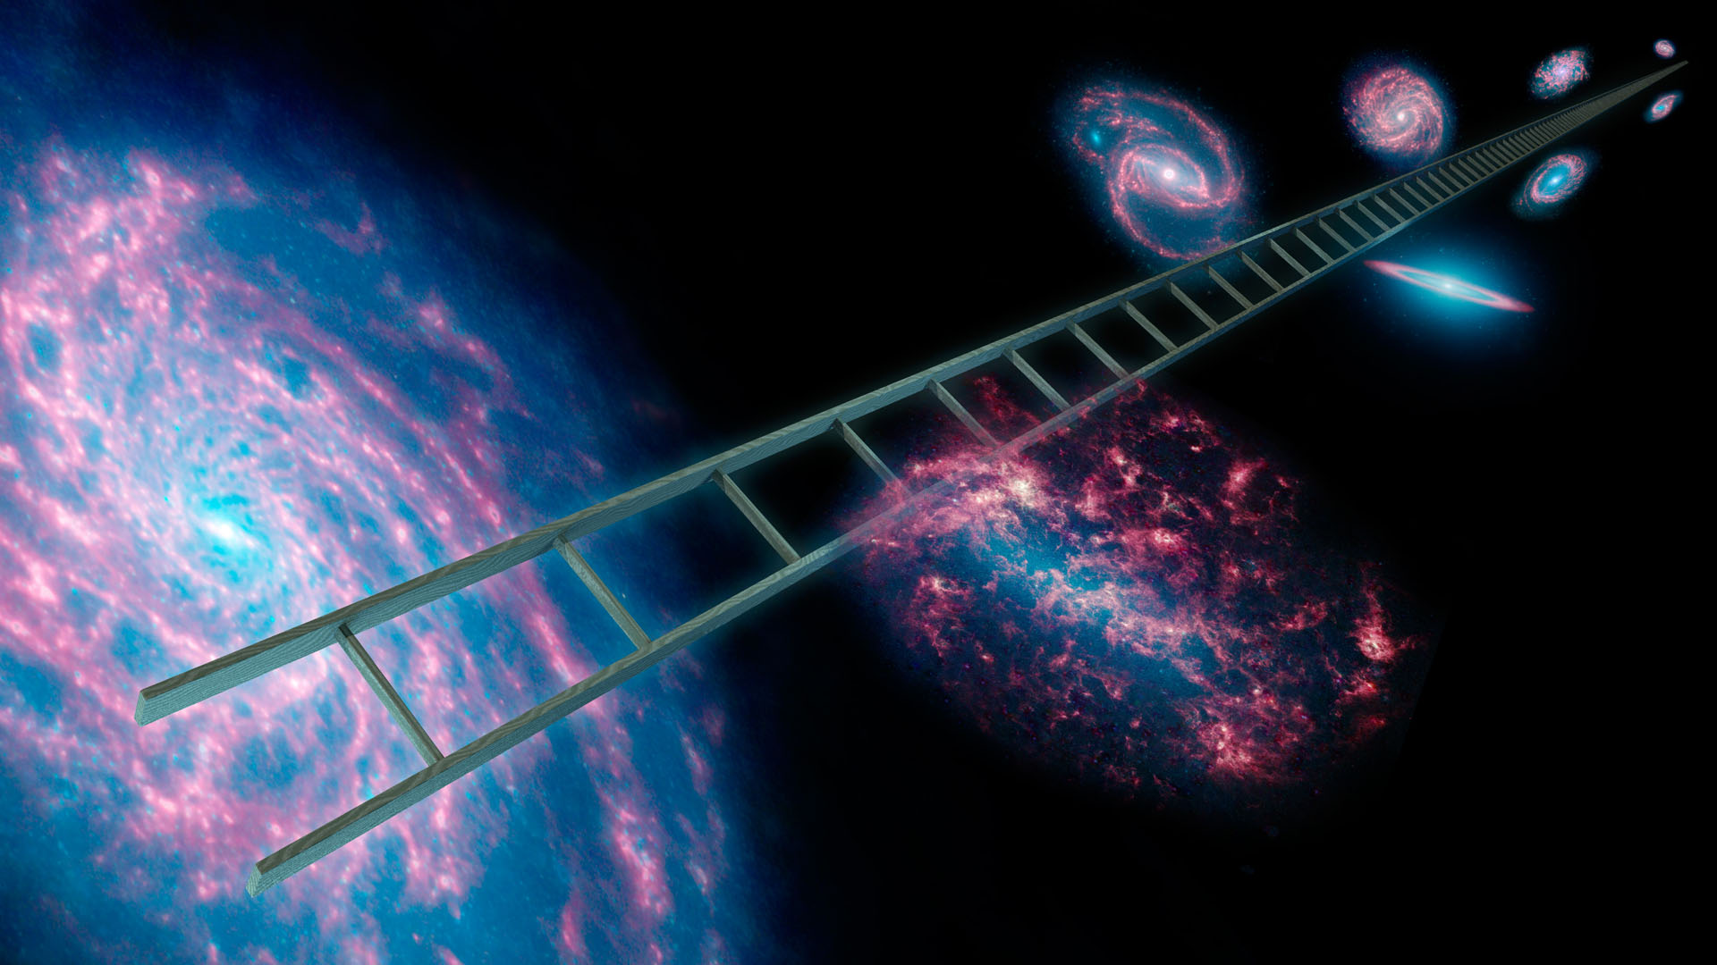
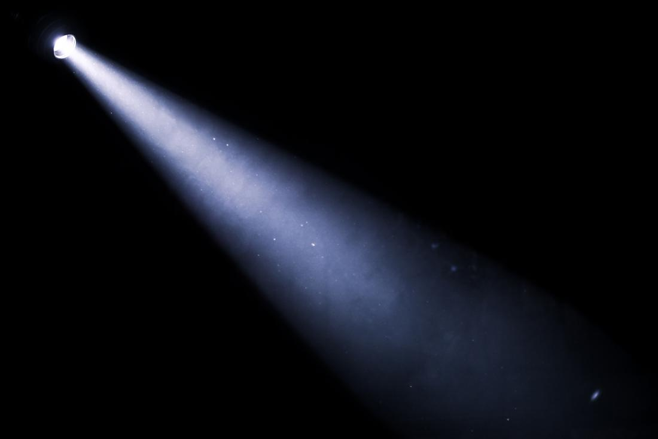
How to estimate distances?

Slide 9
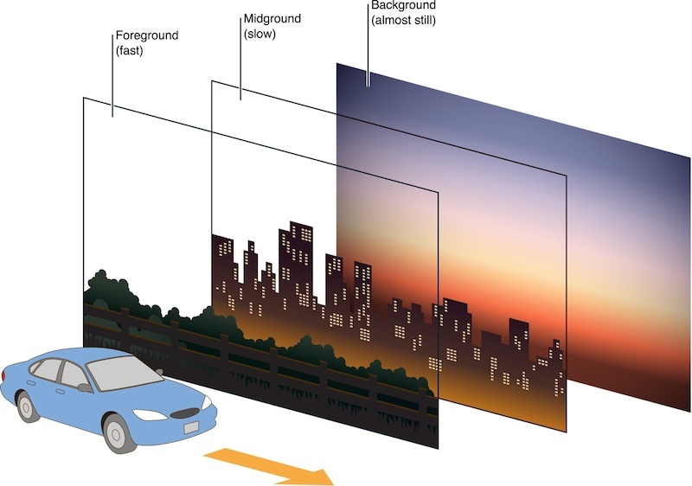
How to estimate distances?
Parallax

Slide 10
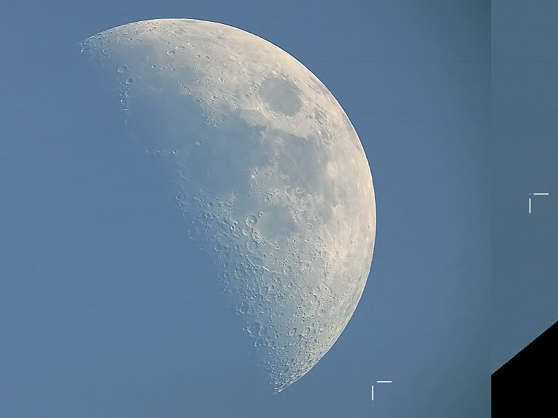
How to estimate distances?
Lunar Parallax
Images by Anthony Ayiomamitis , Athens, Greece,
Pete Lawrence, Selsey, England (May, 2007)

Slide 11
How to estimate distances?
~1000’’
Lunar Parallax
Images by Anthony Ayiomamitis , Athens, Greece,
Pete Lawrence, Selsey, England

Slide 12
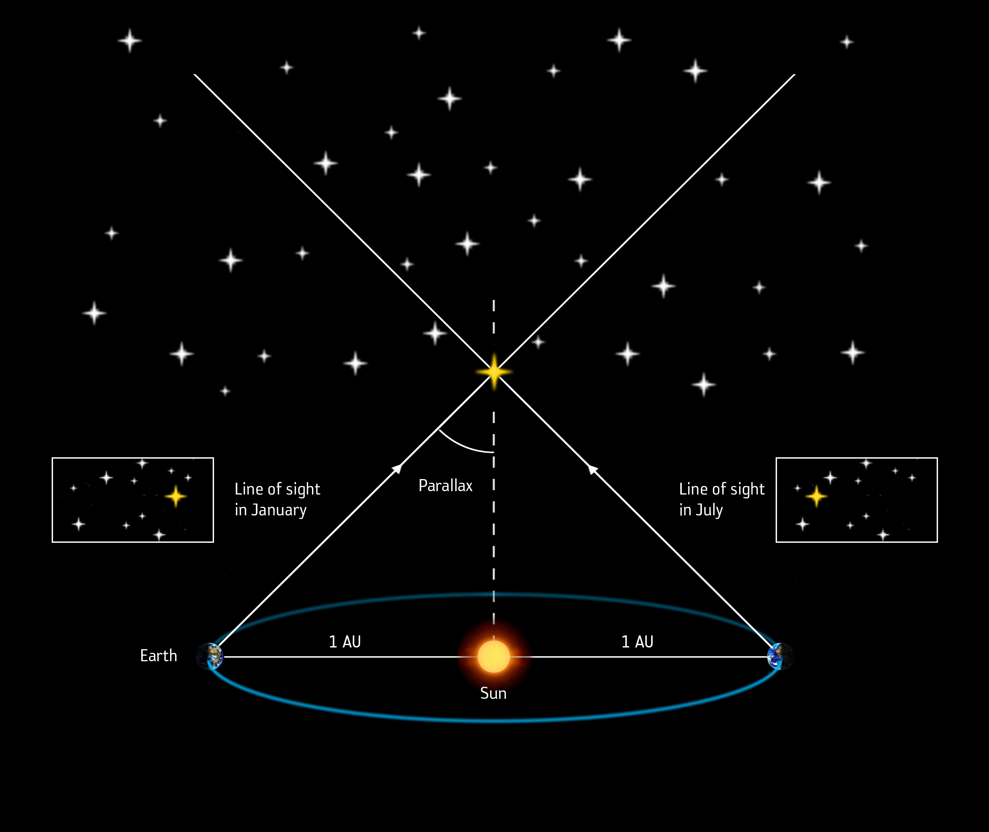
How to estimate distances?

Slide 13
How to estimate distances?
1 parsec = 3.26 ly

Slide 14
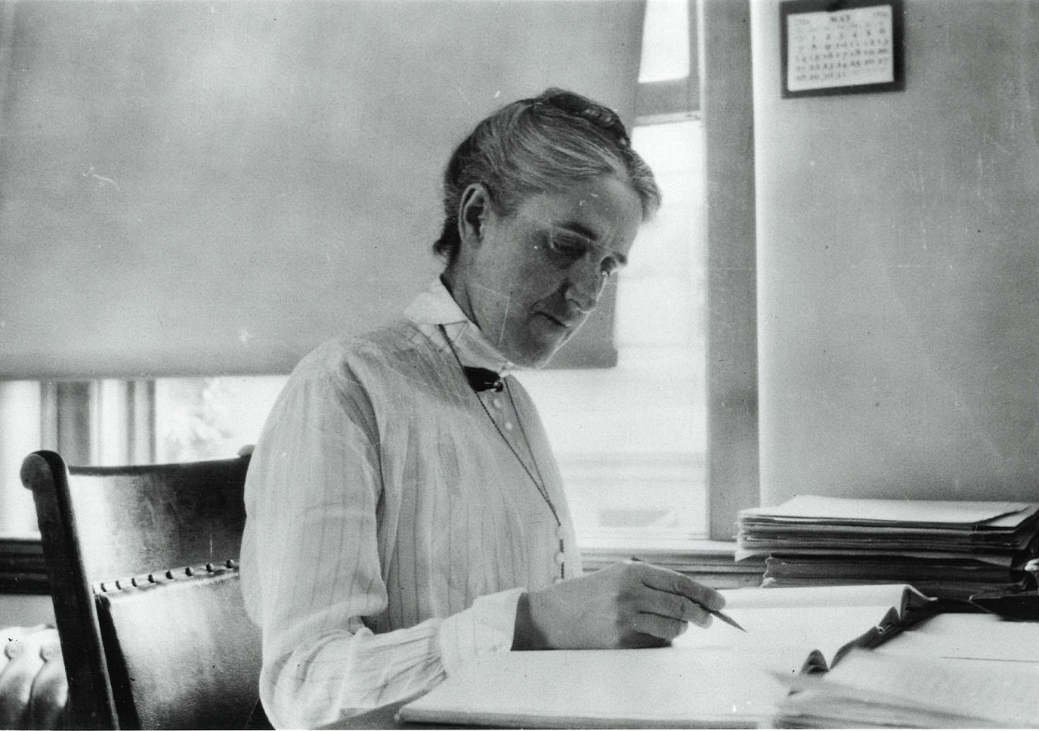
(1868-1921)
1500 1600 1700 1800 1900 2000
Copernicus
Galilei (1564-1642)
Lagrange (1736-1813)
Young
Maxwell
Noether (1882-1935)
Einstein
Brahe (1546-1601)
Kepler
Newton
Hamilton (1805-1865)
Leavitt
Planck
Henrietta Leavitt
Astronomer

Slide 15
(1868-1921)
1500 1600 1700 1800 1900 2000
Copernicus
Galilei (1564-1642)
Lagrange (1736-1813)
Young
Maxwell
Noether (1882-1935)
Einstein
Brahe (1546-1601)
Kepler
Newton
Hamilton (1805-1865)
Leavitt
Planck
Henrietta Leavitt
Astronomer
(Paper)

Slide 16
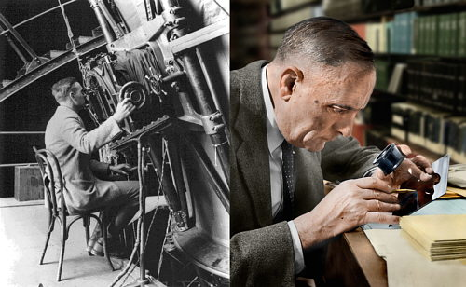
(1889-1953)
1500 1600 1700 1800 1900 2000
Copernicus
Galilei (1564-1642)
Lagrange (1736-1813)
Young
Maxwell
Noether (1882-1935)
Einstein
Brahe (1546-1601)
Kepler
Newton
Hamilton (1805-1865)
Leavitt
Planck
Hubble
Edwin Hubble
Astronomer

Slide 17
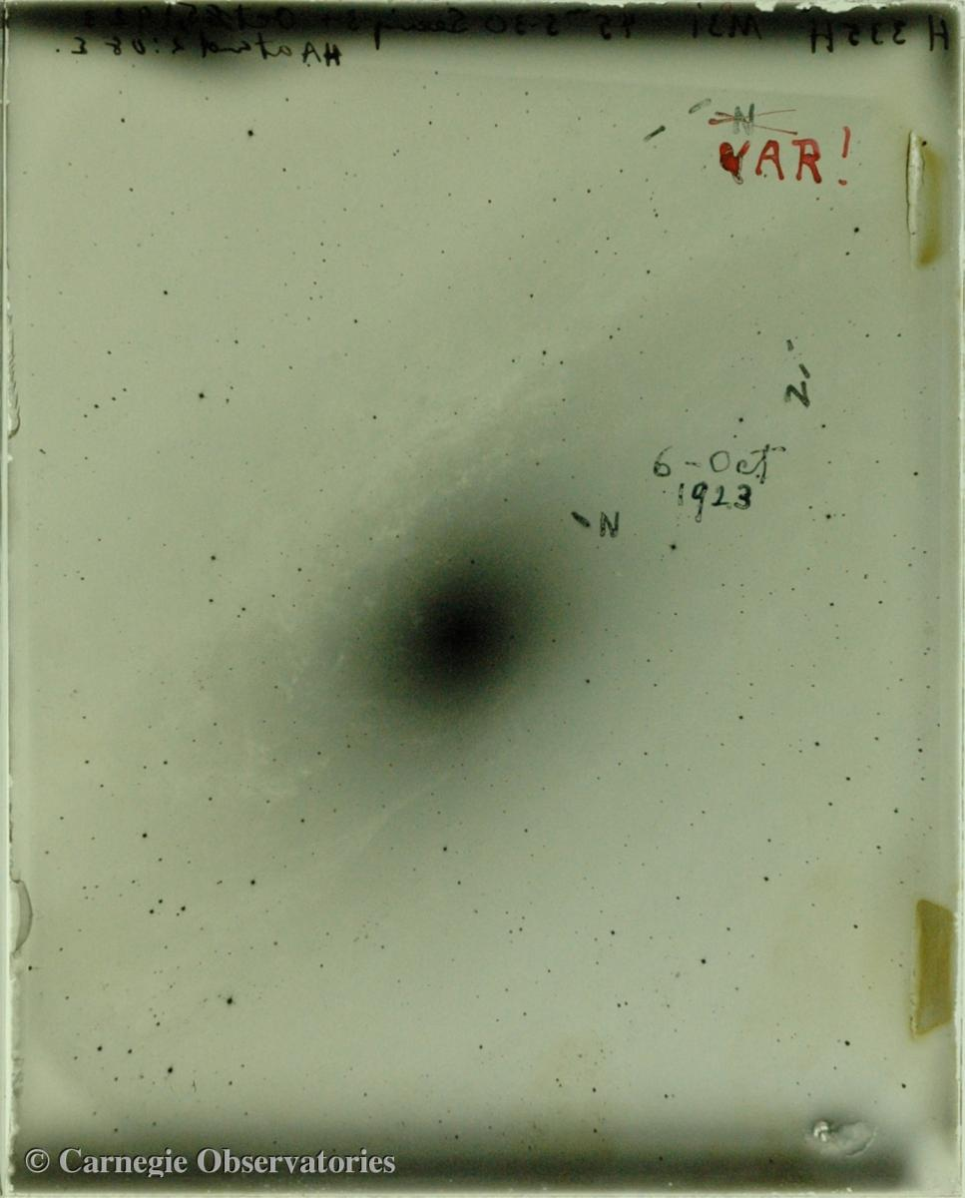
(1889-1953)
1500 1600 1700 1800 1900 2000
Copernicus
Galilei (1564-1642)
Lagrange (1736-1813)
Young
Maxwell
Noether (1882-1935)
Einstein
Brahe (1546-1601)
Kepler
Newton
Hamilton (1805-1865)
Leavitt
Planck
Hubble
Edwin Hubble
Astronomer
Hubble’s original “VAR” plate

Slide 18
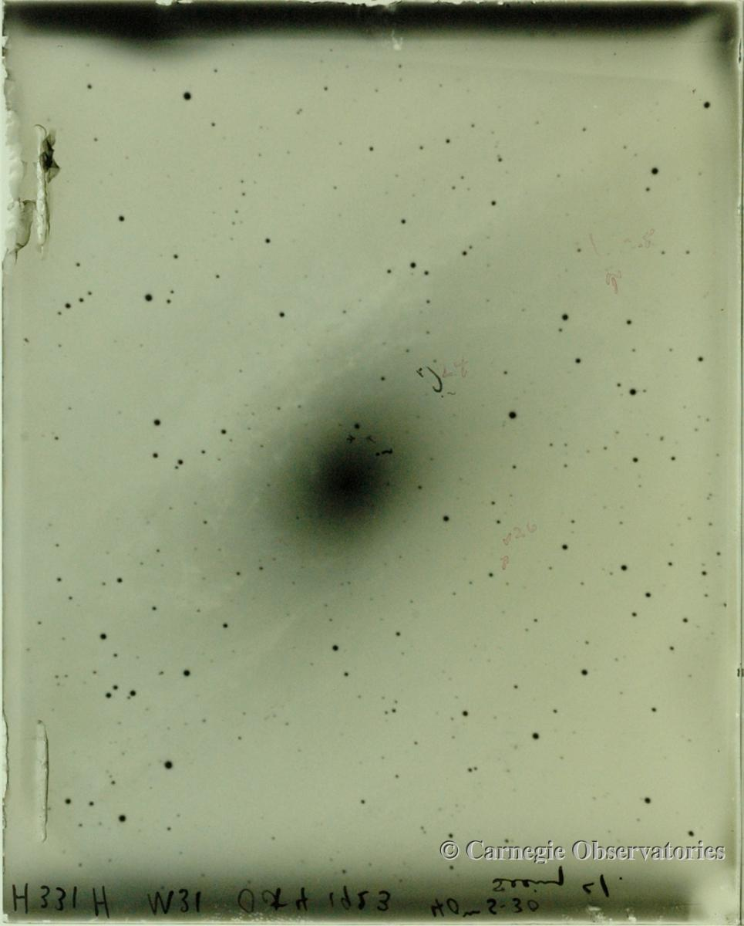
(1889-1953)
1500 1600 1700 1800 1900 2000
Copernicus
Galilei (1564-1642)
Lagrange (1736-1813)
Young
Maxwell
Noether (1882-1935)
Einstein
Brahe (1546-1601)
Kepler
Newton
Hamilton (1805-1865)
Leavitt
Planck
Hubble
Edwin Hubble
Astronomer
Hubble’s original “VAR” plate

Slide 19
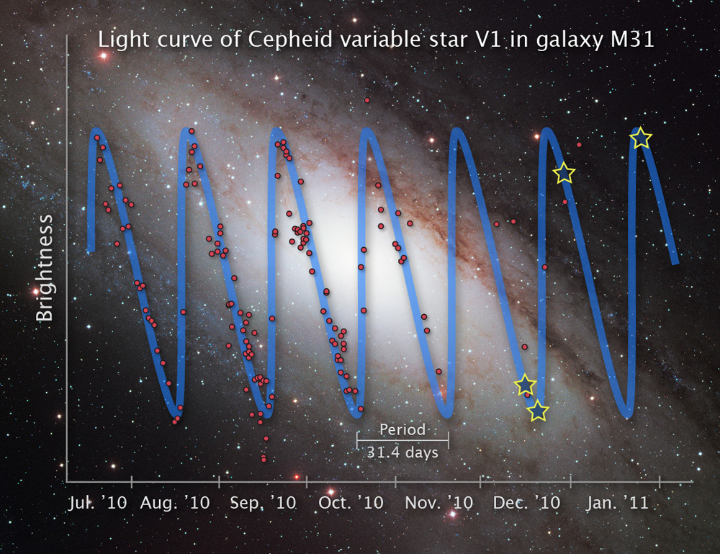
(1889-1953)
1500 1600 1700 1800 1900 2000
Copernicus
Galilei (1564-1642)
Lagrange (1736-1813)
Young
Maxwell
Noether (1882-1935)
Einstein
Brahe (1546-1601)
Kepler
Newton
Hamilton (1805-1865)
Leavitt
Planck
Hubble
Edwin Hubble
Astronomer

Slide 20
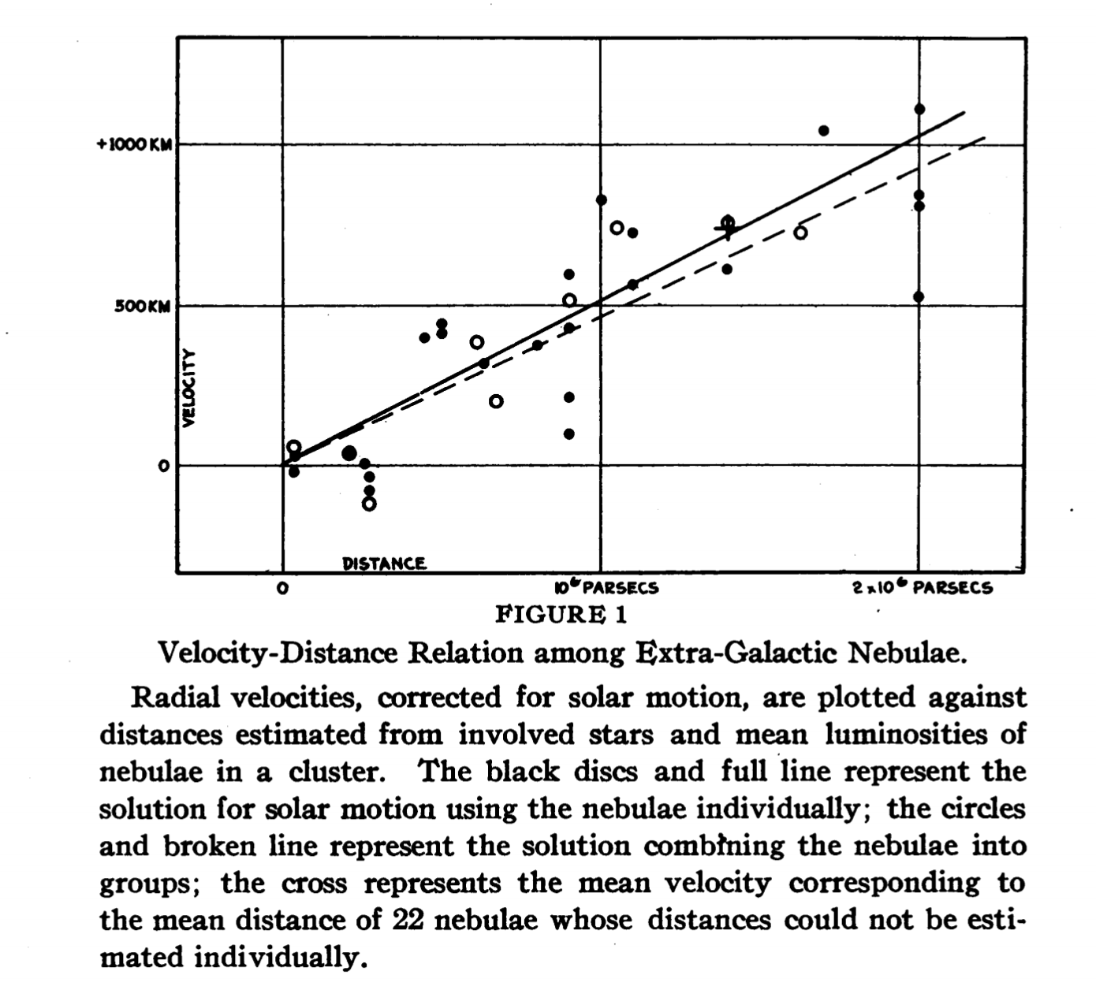
(1889-1953)
1500 1600 1700 1800 1900 2000
Copernicus
Galilei (1564-1642)
Lagrange (1736-1813)
Young
Maxwell
Noether (1882-1935)
Einstein
Brahe (1546-1601)
Kepler
Newton
Hamilton (1805-1865)
Leavitt
Planck
Hubble
Edwin Hubble
Astronomer

Slide 21
(1889-1953)
1500 1600 1700 1800 1900 2000
Copernicus
Galilei (1564-1642)
Lagrange (1736-1813)
Young
Maxwell
Noether (1882-1935)
Einstein
Brahe (1546-1601)
Kepler
Newton
Hamilton (1805-1865)
Leavitt
Planck
Hubble
Edwin Hubble
Astronomer
HOW?

Slide 22
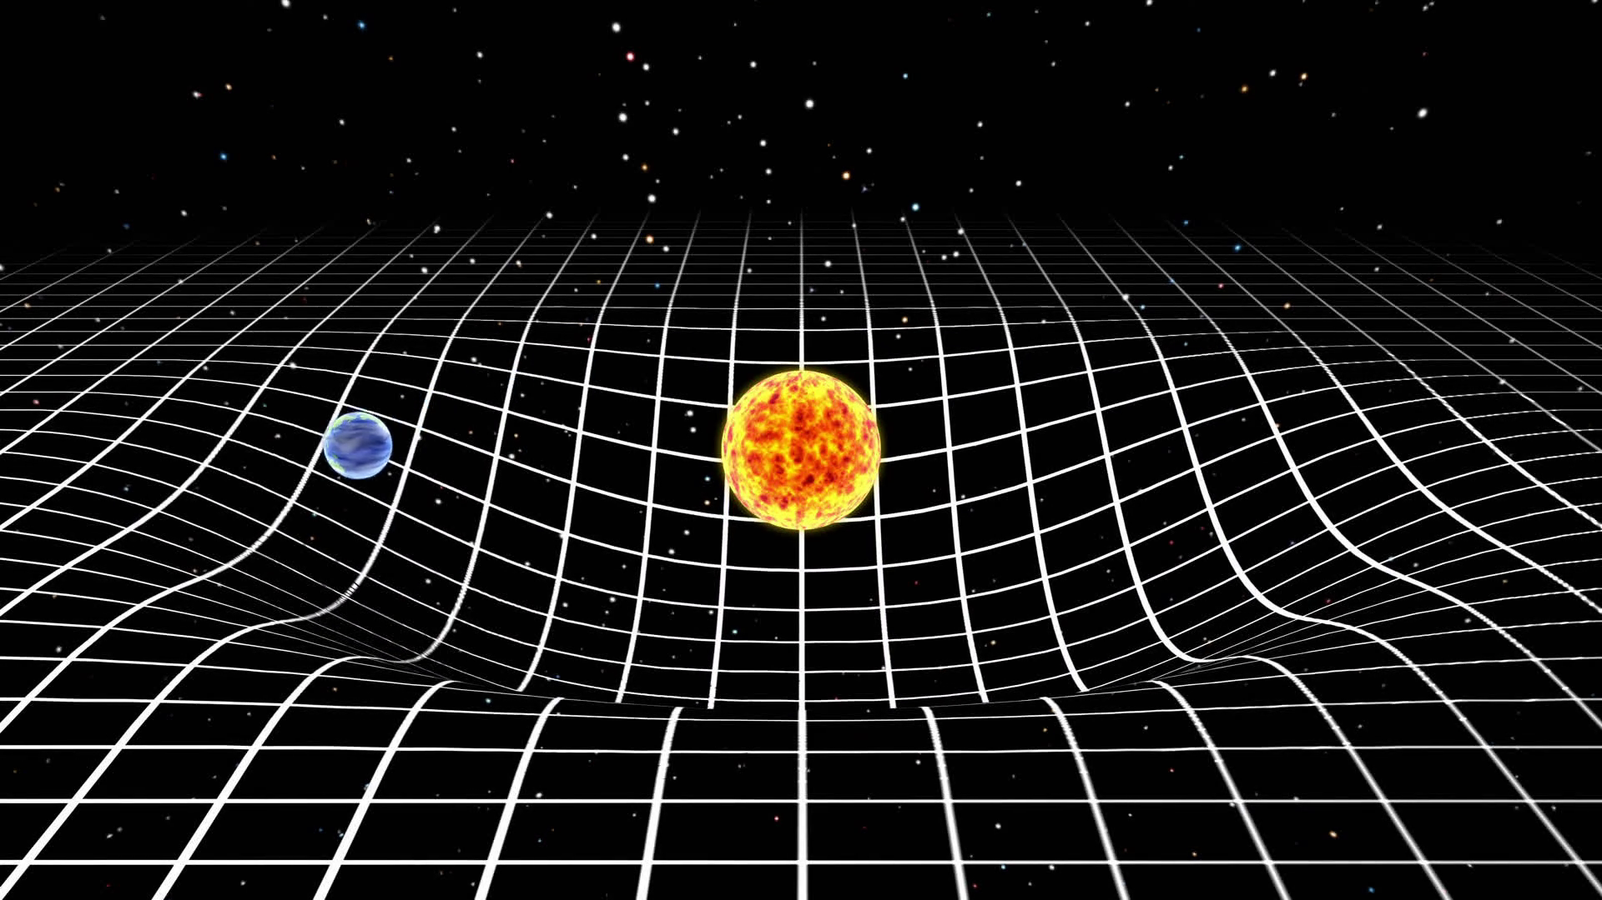
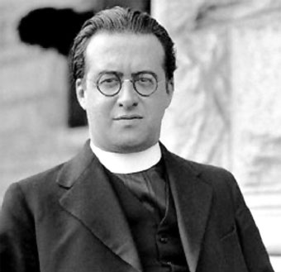
(1894-1966)
Lemaître
1500 1600 1700 1800 1900 2000
Copernicus
Galilei (1564-1642)
Lagrange (1736-1813)
Young
Maxwell
Noether (1882-1935)
Einstein
Brahe (1546-1601)
Kepler
Newton
Hamilton (1805-1865)
Leavitt
Einstein’s General Relativity (1918)
Planck
Hubble
Georges Lemaître
Astronomer

Slide 23
(1894-1966)
Lemaître
1500 1600 1700 1800 1900 2000
Copernicus
Galilei (1564-1642)
Lagrange (1736-1813)
Young
Maxwell
Noether (1882-1935)
Einstein
Brahe (1546-1601)
Kepler
Newton
Hamilton (1805-1865)
Leavitt
Planck
Hubble
Georges Lemaître
Astronomer

Slide 24
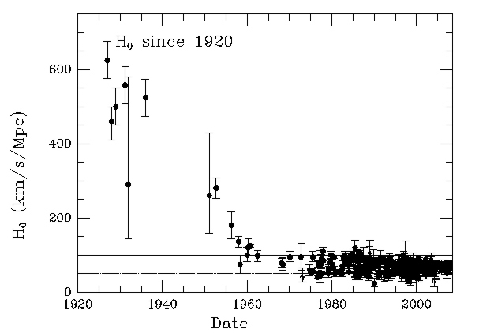
Lemaître
1500 1600 1700 1800 1900 2000
Copernicus
Galilei (1564-1642)
Lagrange (1736-1813)
Young
Maxwell
Noether (1882-1935)
Einstein
Brahe (1546-1601)
Kepler
Newton
Hamilton (1805-1865)
Leavitt
Planck
Hubble
Hubble-Lemaître Constant

Slide 25
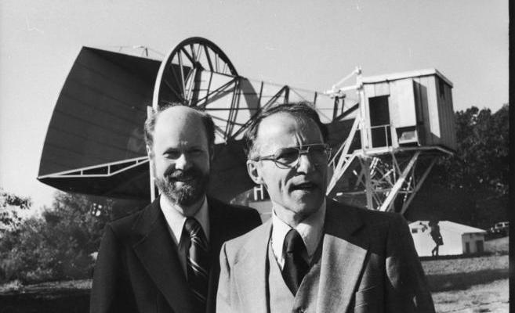
Lemaître
1500 1600 1700 1800 1900 2000
Copernicus
Galilei (1564-1642)
Lagrange (1736-1813)
Young
Maxwell
Noether (1882-1935)
Einstein
Brahe (1546-1601)
Kepler
Newton
Hamilton (1805-1865)
Leavitt
Planck
Hubble
(1933-)
(1936-)
Robert Wilson
Arno Penzias

Slide 26
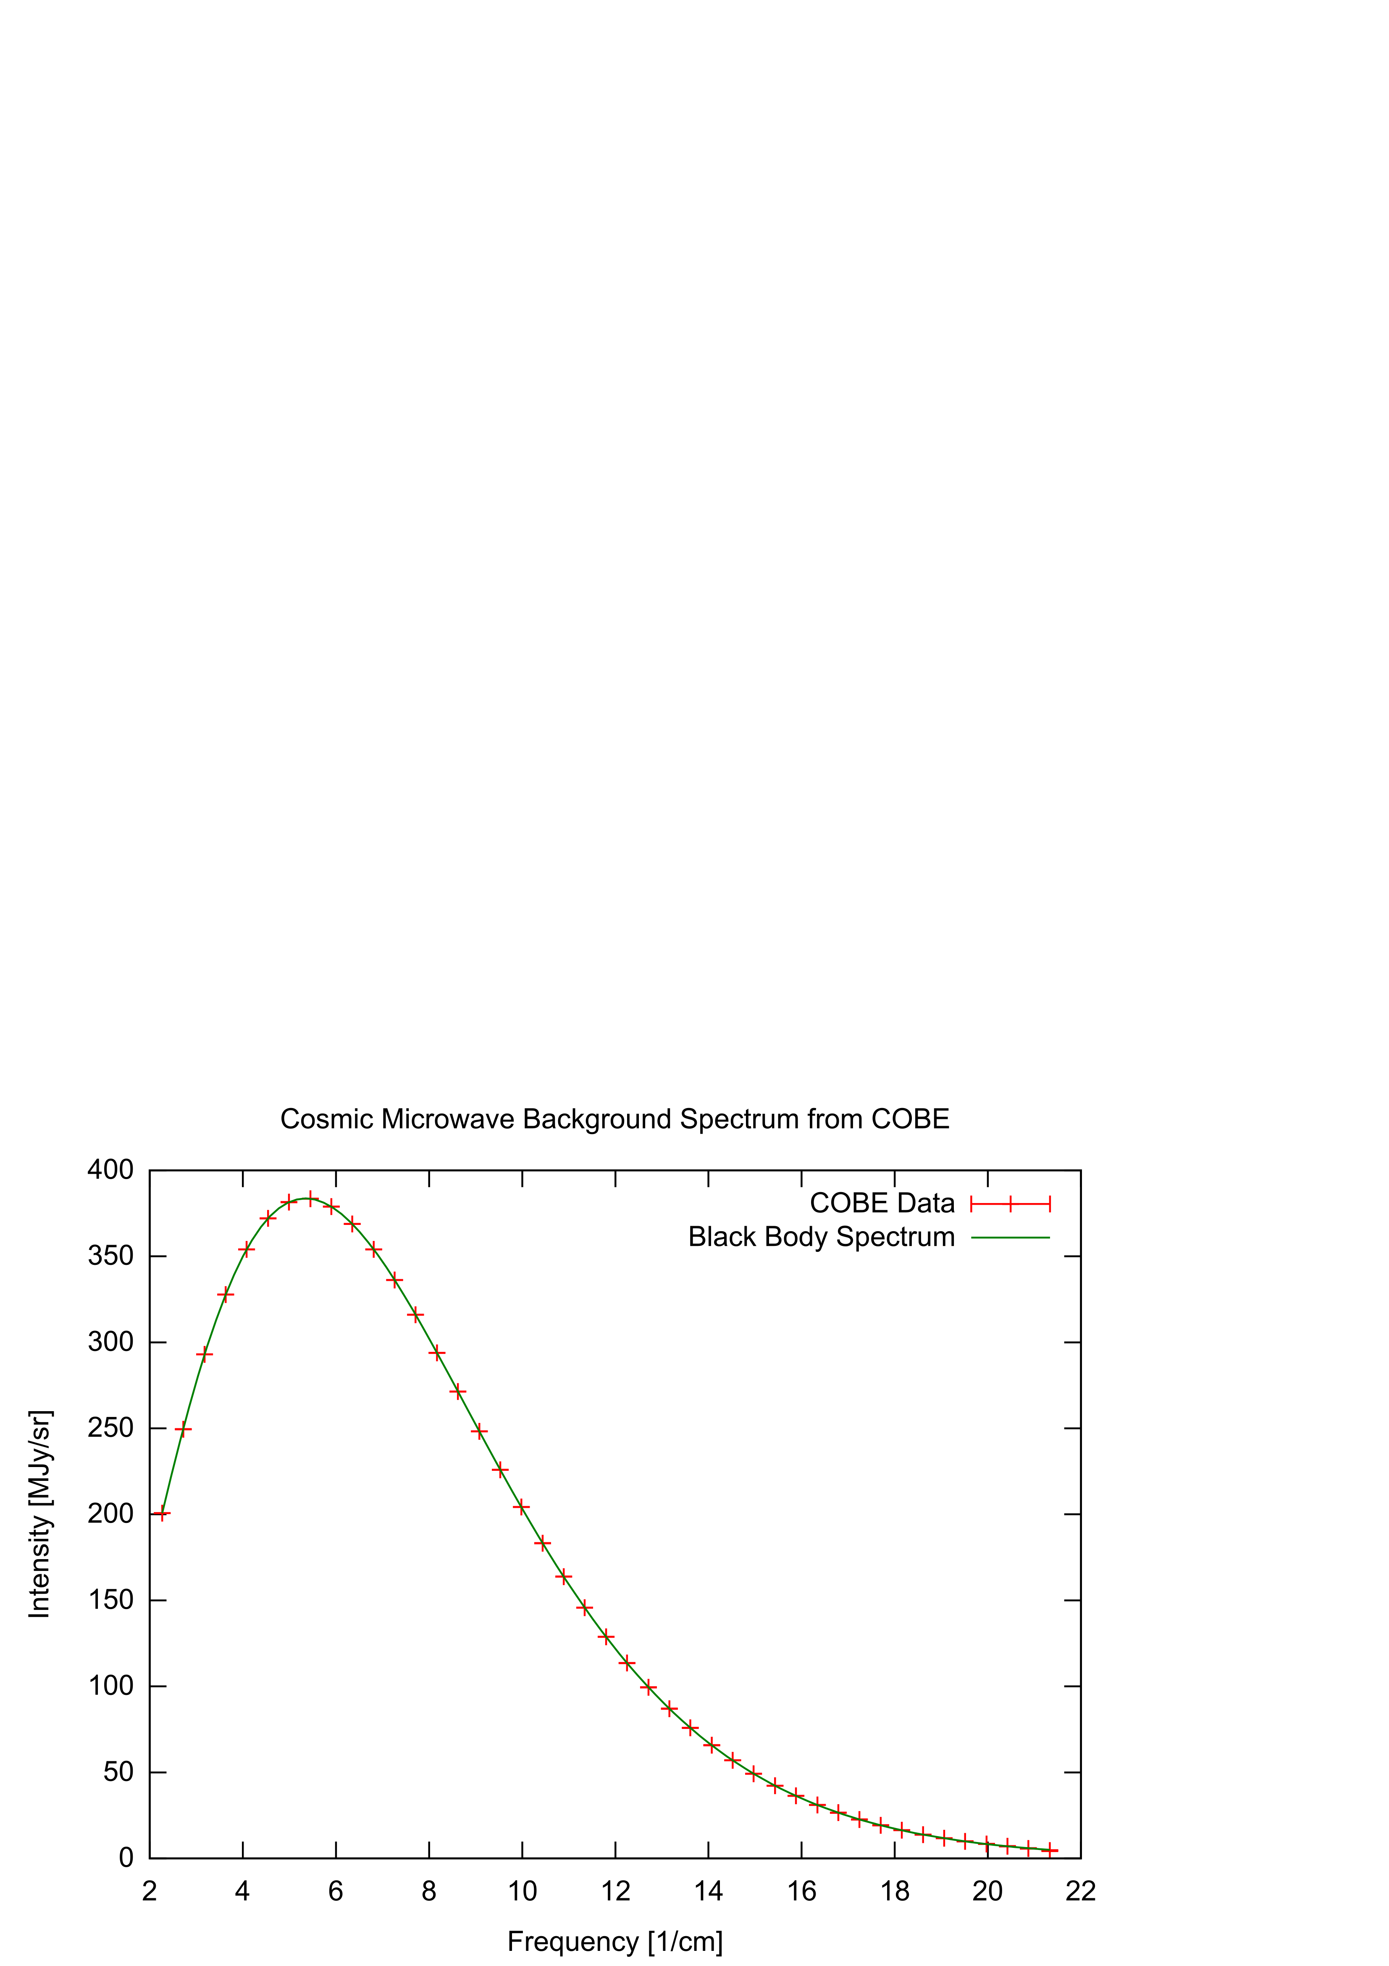
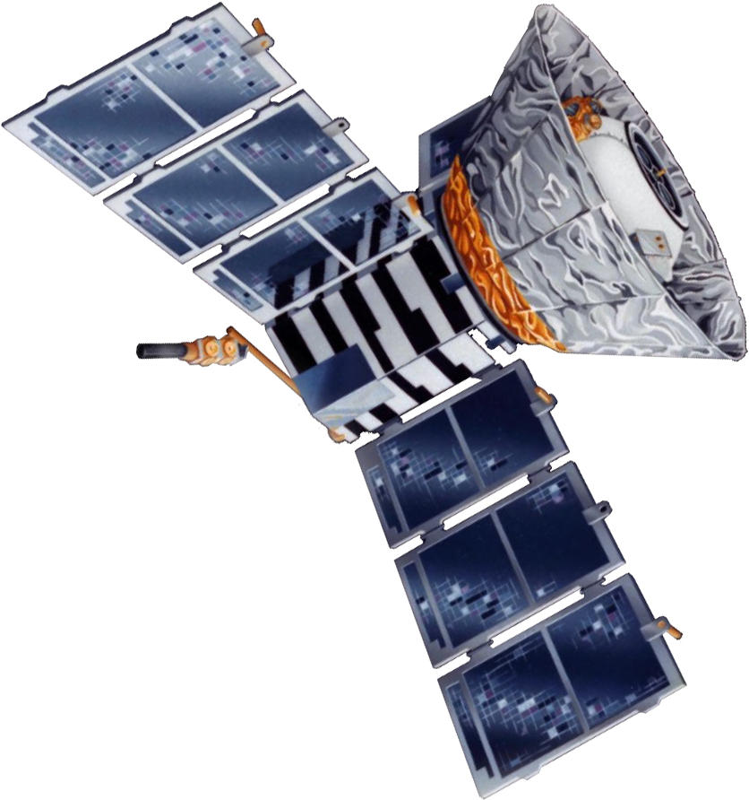
Lemaître
1500 1600 1700 1800 1900 2000
Copernicus
Galilei (1564-1642)
Lagrange (1736-1813)
Young
Maxwell
Noether (1882-1935)
Einstein
Brahe (1546-1601)
Kepler
Newton
Hamilton (1805-1865)
Leavitt
Planck
Hubble
(1989-1993)
COBE

Slide 27
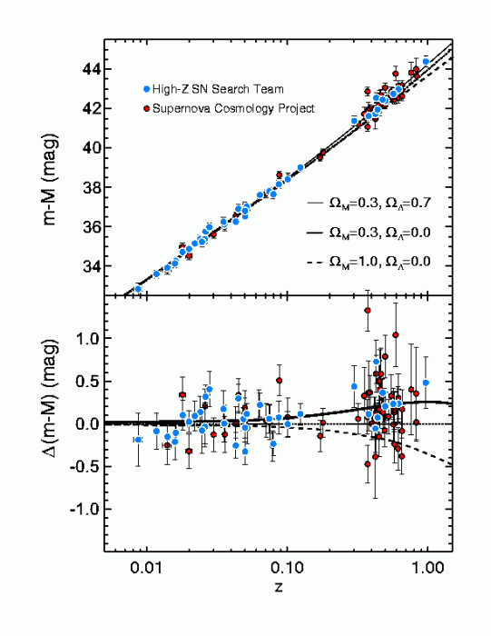
Lemaître
1500 1600 1700 1800 1900 2000
Copernicus
Galilei (1564-1642)
Lagrange (1736-1813)
Young
Maxwell
Noether (1882-1935)
Einstein
Brahe (1546-1601)
Kepler
Newton
Hamilton (1805-1865)
Leavitt
Planck
Hubble

